Slide 1
5 Themes of Geography
World Geography

Slide 3
Geography
What is Geography?
Geography is the study of people, places, environments and resources, and how they relate to each other.

Slide 4
5 Themes of Geography
Location
Place
Human/ Environment Interaction
Movement
Regions

Slide 5
Location
Location describes where something is or where something happened.
Absolute Location uses latitude and longitude; Relative Location describes location as it relates to something else.
Laramie = 41.3114° N, 105.5906° W
Laramie is 45 minutes west of Cheyenne

Slide 6
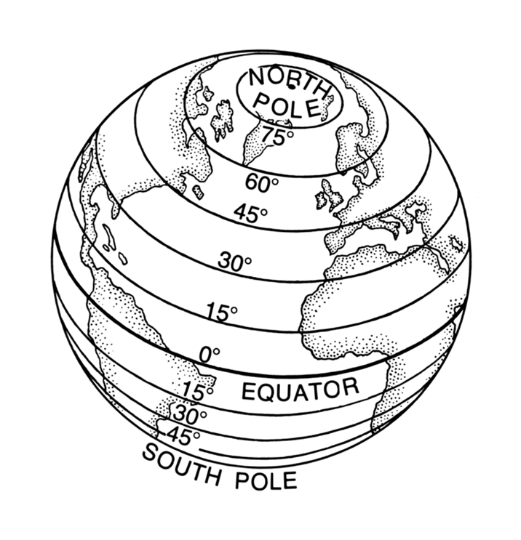
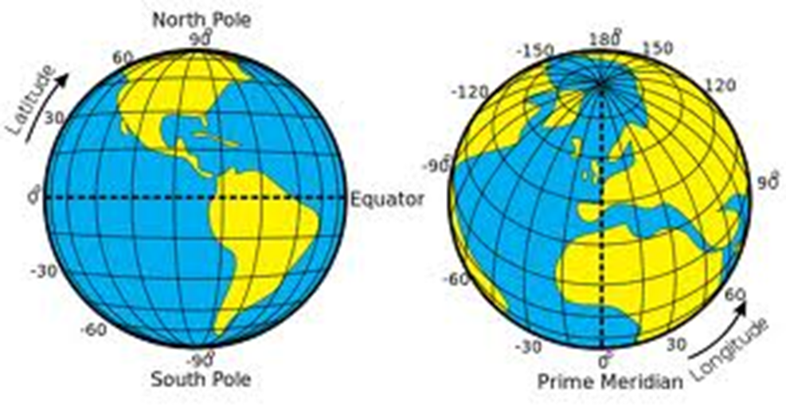

Slide 7
Place
Places describes what a place is like using physical and human features.
Physical Features are found in nature; Human Features relate to humans and are man-made.
Wyoming has a dry climate and is mountainous.
Wyoming is primarily English speaking and has a democratic government.

Slide 8
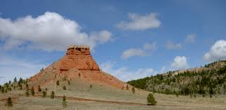
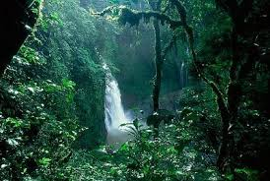

Slide 9
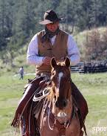
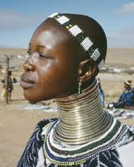

Slide 10
Human/ Environment Interaction
How humans are affected by, and adapt to, their environment.
People in Wyoming having remote starters for their cars.
How humans affect their environment—positively or negatively.
Reduction in buffalo populations since the 1800s.

Slide 11
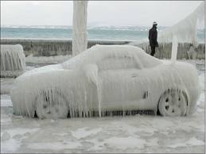
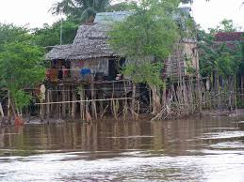
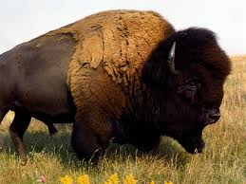
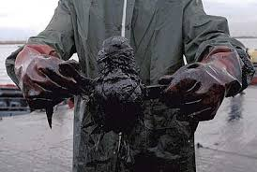

Slide 12
Movement
Movement of people, goods and ideas.
Movement of People: Immigration
Movement of Goods: Trade, food
Movement of Ideas: Inventions, religions, cultural customs, language

Slide 14
Regions
Regions have common physical features.
The Middle East is primarily Arabic speaking and Muslim.
Regions also have common human features.
New England states have a similar climate and urban culture.

Slide 15
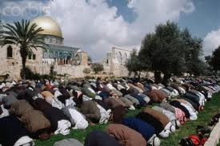
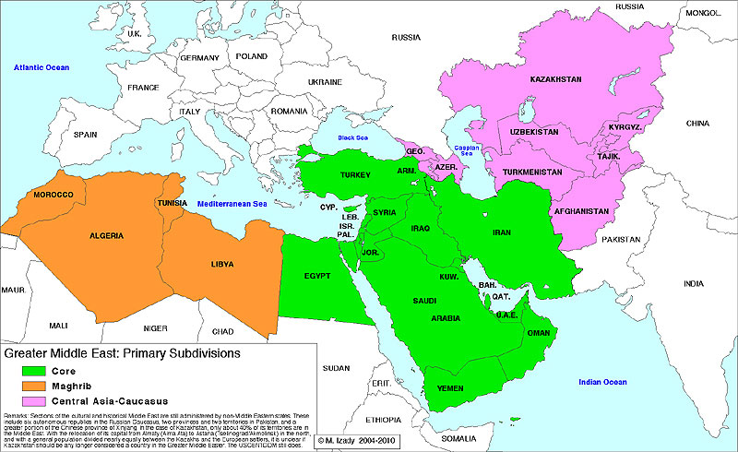

Slide 16
