Slide 1
5 Themes of North America
7th Grade World Geography

Slide 2
Location
In your own words, describe the relative location of North America in the box provided.

Slide 3
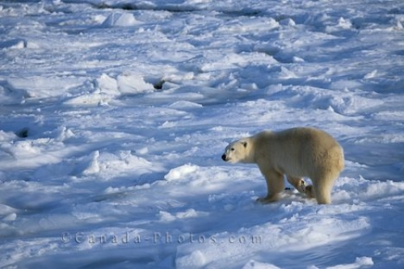
Place: Physical Features
Climates ranging from polar ice cap to tropical rainforest.
Major Mountain Ranges:
Rocky Mountains (US & Canada)
Appalachian Mountains (US)
Cascade Mountains (US)
Sierra Nevada Mountains (US)
Sierra Madre Occidental (Mexico)
Sierra Madre Oriental (Mexico)

Slide 4
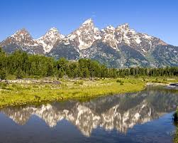
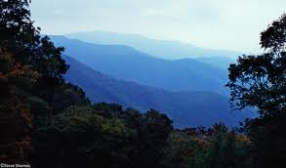
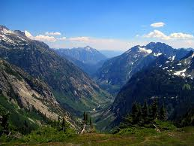
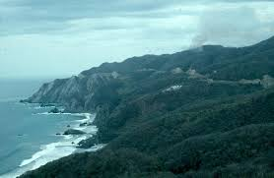

Slide 5
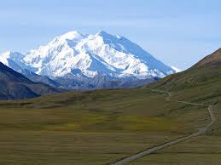
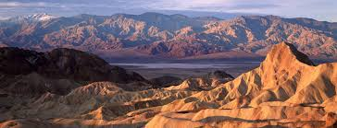
Place: Physical Features
Highest Point
Mt. McKinley = 20, 237 ft
Lowest Point
Death Valley = -282 ft

Slide 6
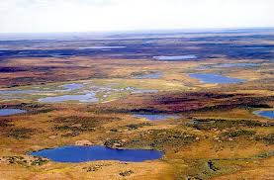
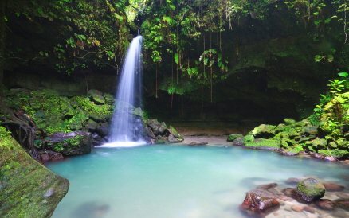
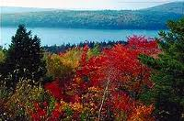
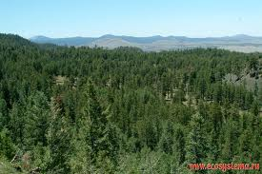
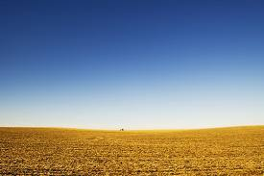

Slide 7
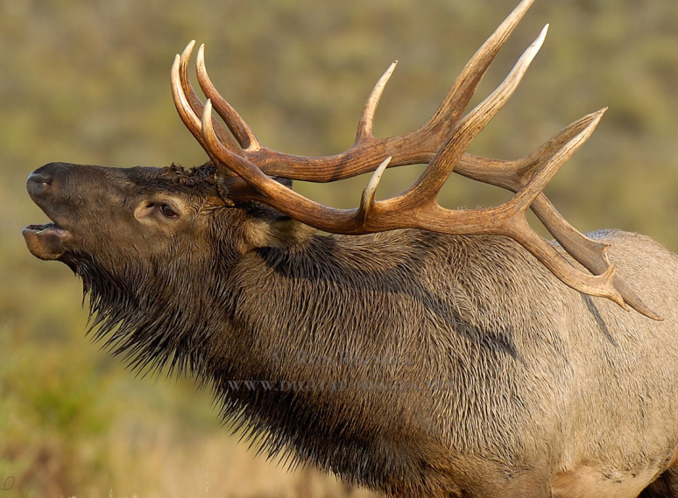
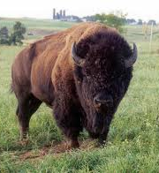
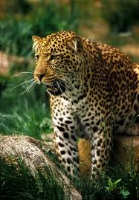
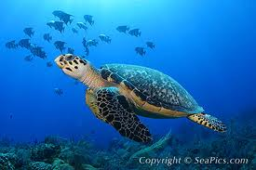
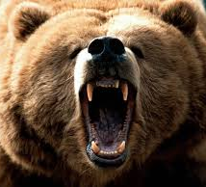
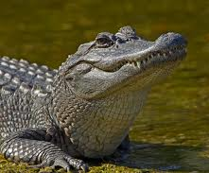

Slide 8
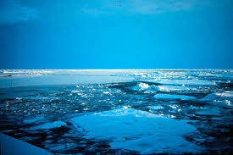
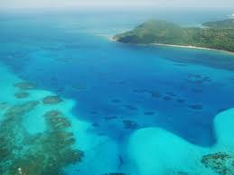
Place: Physical Features
Oceans & Seas
Arctic Ocean
Pacific Ocean
Atlantic Ocean
Gulf of Mexico
Caribbean Sea

Slide 9
Place: Physical Features
Lakes
Great Bear Lake (Canada)
Great Slave Lake (Canada)
Great Lakes: Superior, Michigan, Huron, Erie, Ontario (US & Canada Border)
Great Salt Lake (US)
Lago de Nicaragua (Nicaragua)

Slide 10
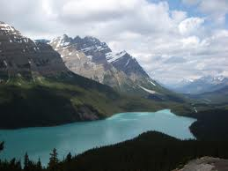
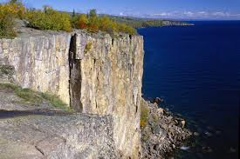
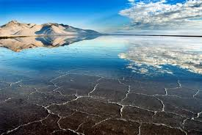

Slide 11
Place: Physical Features
Rivers
Mackenzie River (Canada)
N. & S. Saskatchewan River (Canada)
Mississippi River (US)
Ohio River (US)
Missouri River (US)
Yukon River (US: Alaska)
Rio Grande River (US & Mexico border)

Slide 12
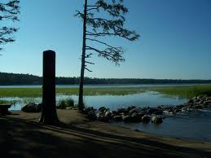
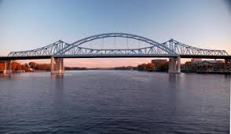

Slide 13
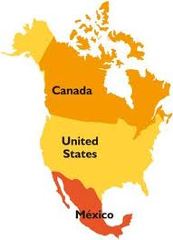
Place: Human Features
Countries & Capitals:
Canada: Ottawa
United States: Washington, D.C.
Mexico: Mexico City

Slide 14
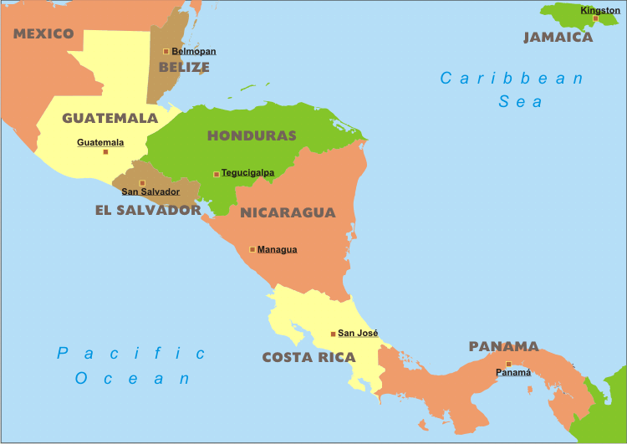
Place: Human Features
Countries & Capitals:
Central America:
Guatemala: Guatemala City
Belize: Belmopan
Honduras: Tegucigalpa
El Salvador: San Salvador
Nicaragua: Managua
Costa Rica: San Jose
Panama: Panama City

Slide 15
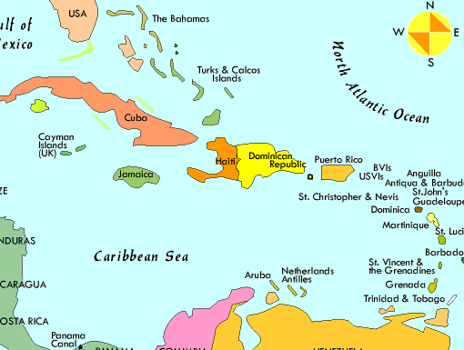
Place: Human Features
Countries & Capitals:
Caribbean Islands:
Cuba: Havana
Jamaica: Kingston
Haiti: Port-au-Prince
Dominican Republic: Santo Domingo
Puerto Rico: San Juan
Bahamas: Nassau

Slide 16
Place: Human Features
Major Languages:
English (US, Canada, and several Caribbean islands)
Spanish (Mexico, Central America, and Caribbean islands)
French (parts of Canada, and some Caribbean islands)

Slide 17
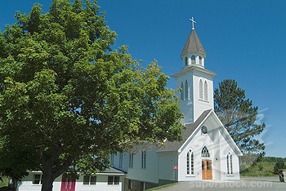
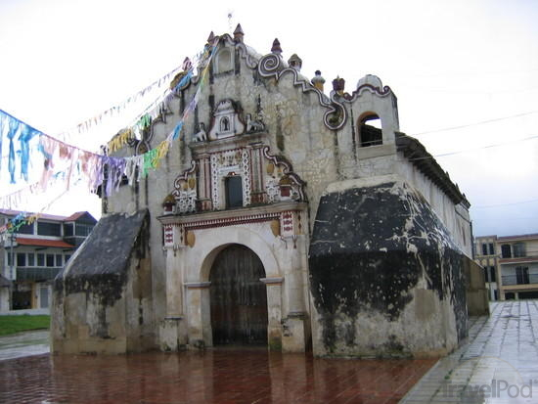
Place: Human Features
Christianity is the major religion:
Protestant (parts of US and Canada)
Catholic (parts of US and French-speaking Canada, Mexico, Central America, Caribbean)

Slide 18
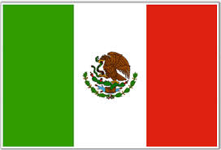
Place: Human Features
Government:
Canada =Parliamentary democracy
USA = Constitution based federal republic
Mexico = federal republic

Slide 19
Human/ Environment Interaction
Natural Resources
Canada = copper, gold, petroleum, natural gas, coal, diamonds, silver, timber, fish
USA = coal, copper, lead, uranium, gold, iron, silver, zinc, petroleum, natural gas, mercury, nickel
Mexico = petroleum, natural gas, silver, copper, lead, gold, timber, tourism

Slide 20
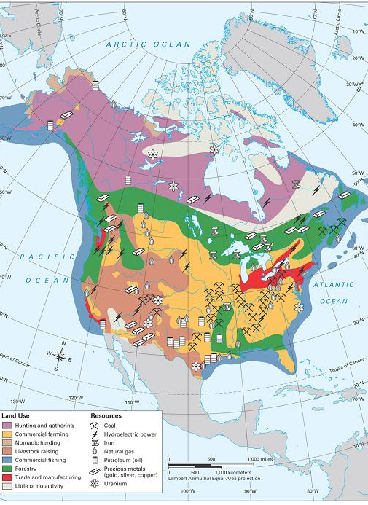

Slide 21
Human/ Environment Interaction
Natural Hazards
Canada = permafrost, cyclonic storms
USA = tsunamis, earthquakes, volcanoes, hurricanes, tornadoes, mudslides, forest fires, permafrost
Mexico = tsunamis, earthquakes, volcanoes, hurricanes

Slide 22
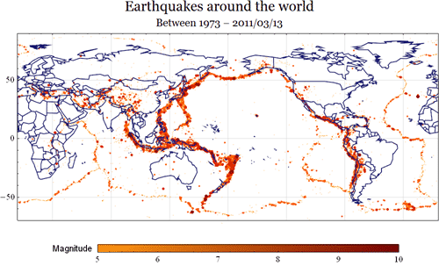

Slide 23
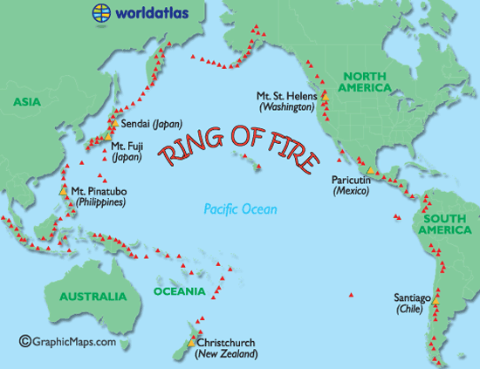

Slide 24
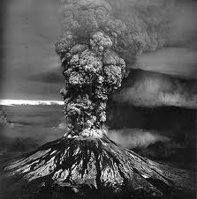
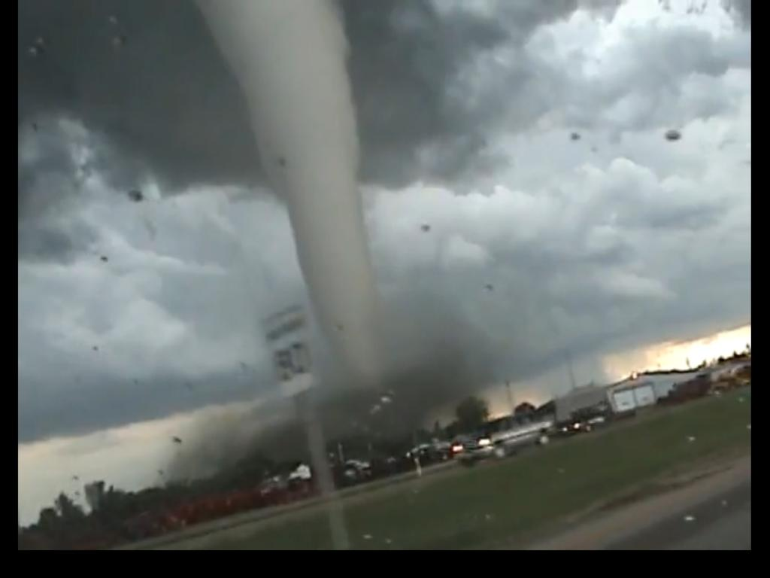
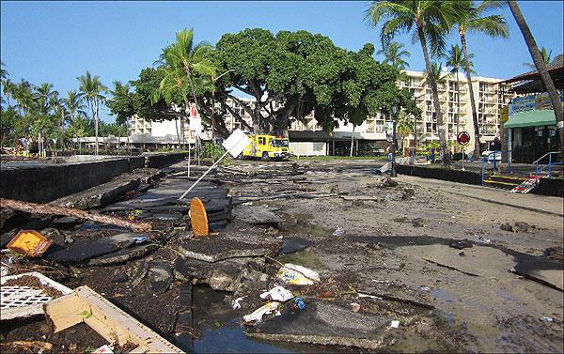
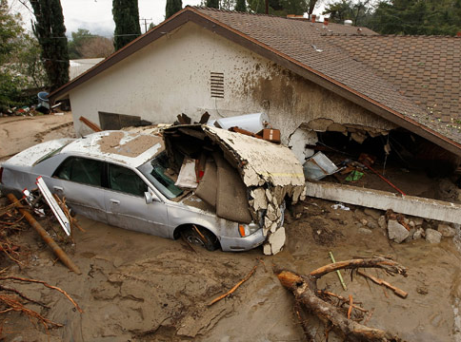

Slide 25
Human/ Environment Interaction
Environmental Issues
Canada = air pollution, acid rain, contaminated oceans
USA = air and water pollution, acid rain, carbon dioxide emissions, limited natural freshwater in west, desertification
Mexico = water scarcity, erosion, deforestation, desertification, serious air and water pollution

Slide 26
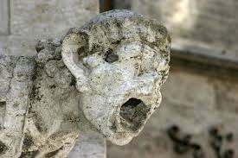
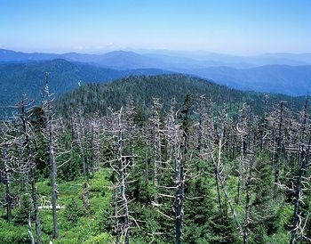
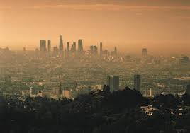

Slide 27
Movement
Movement of People:
European colonists and immigrants settled most of North America
English and French in the US and Canada
Spanish in Mexico, Central America, and Caribbean
Slaves brought over from Africa
Large slave populations in the southern US, Haiti and Dominican Republic
Disruption and destruction of Native peoples
30 – 100 million in 1492
6 million in 1650
Continued immigration (1 million to US each year)

Slide 28
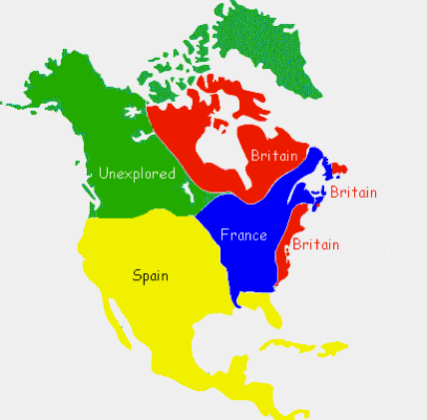

Slide 29
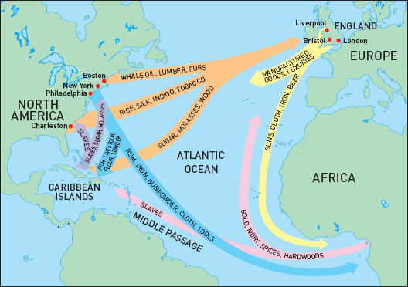

Slide 30
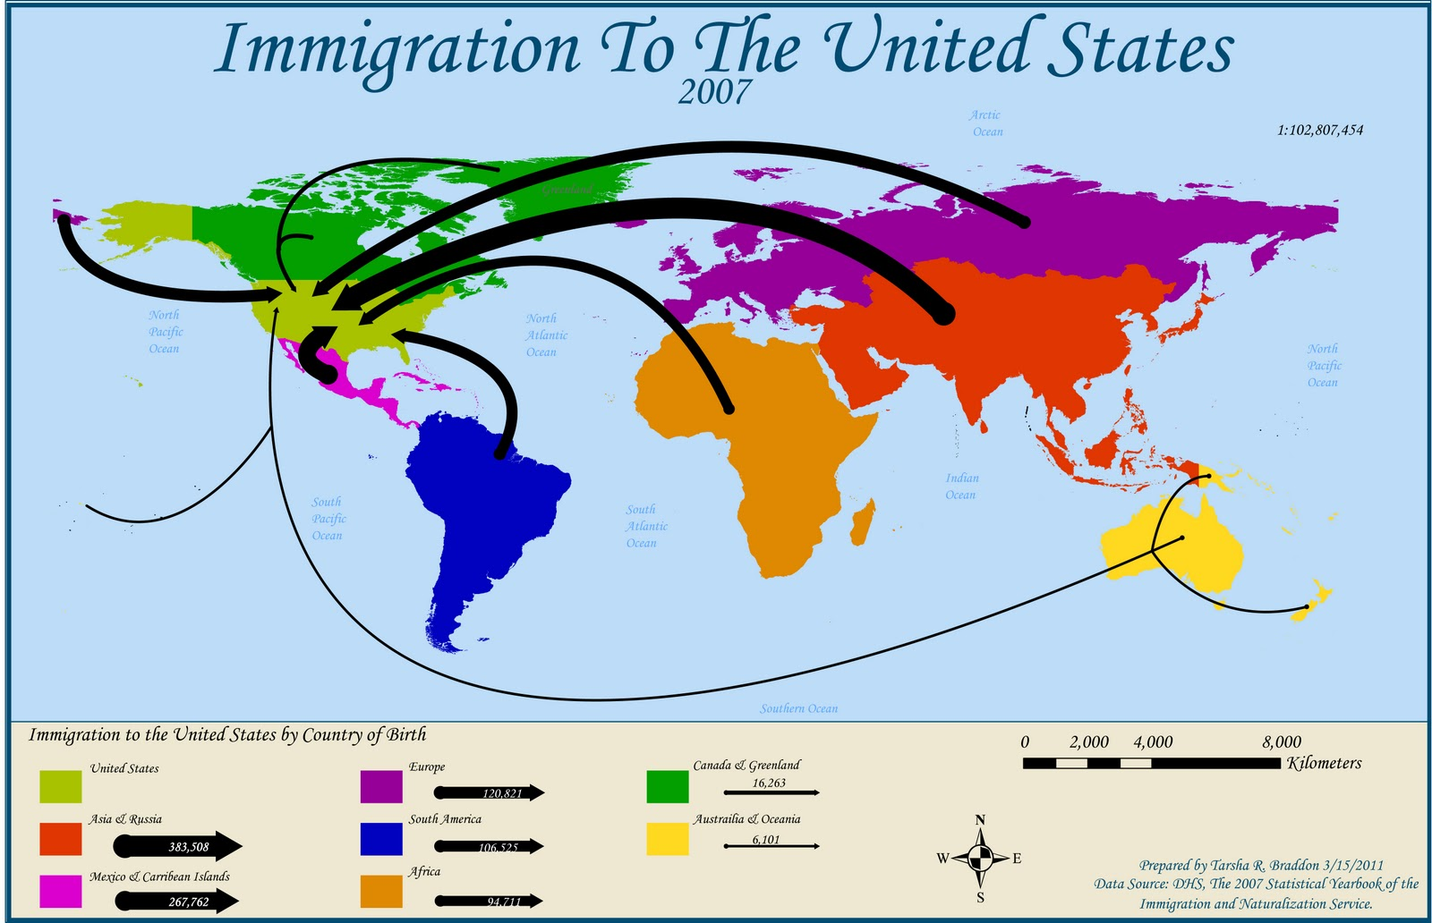

Slide 31
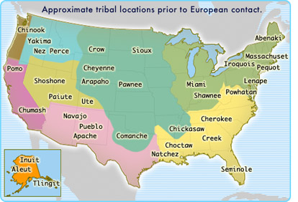

Slide 32
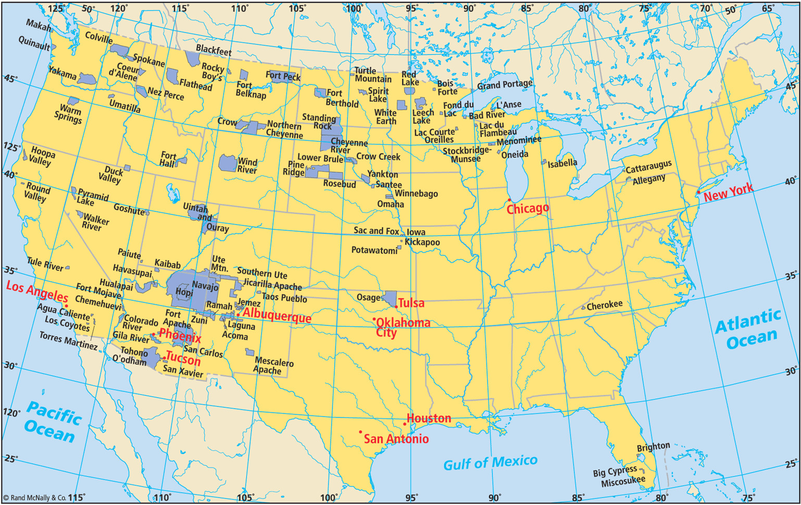

Slide 33
Movement
Movement of Goods
Columbian Exchange
Europeans brought disease, domesticated animals, wheat
Native Americans shared disease, corn, tomatoes, new animals
Canada Today = Exports vehicles & Imports machinery
US Today = Exports capital goods & imports industrial supplies and consumer goods
Mexico Today = Exports manufactured goods & imports metalworking machines

Slide 34
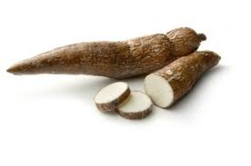
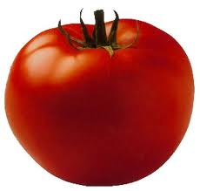
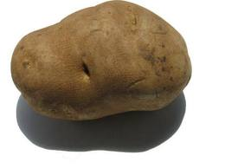
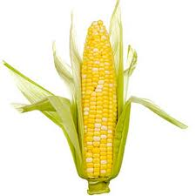
FROM AMERICA TO EUROPE

Slide 35
FROM EUROPE TO AMERICA

Slide 36
Movement
Movement of Ideas
Religion
Christianity (80-90%) began in the Middle East
Government
Democratic ideas began in ancient Greece
Popular culture
American movies, fashion, music, etc.

Slide 37
Regions
United States & Canada
Mexico & Central America
Caribbean Islands

