Slide 1
The Physical World
Continents & Oceans

Slide 2
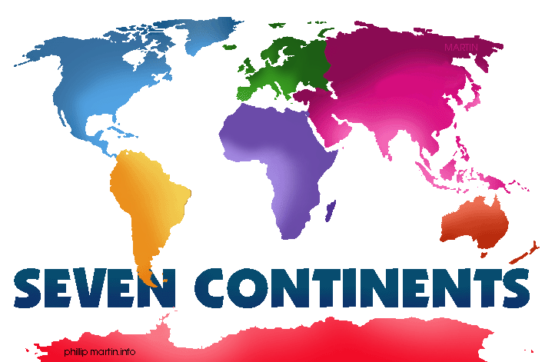
Which Continent?
North America
South America
Asia
Europe

Slide 3
Which Continent?
North America
South America
Asia
Australia

Slide 4
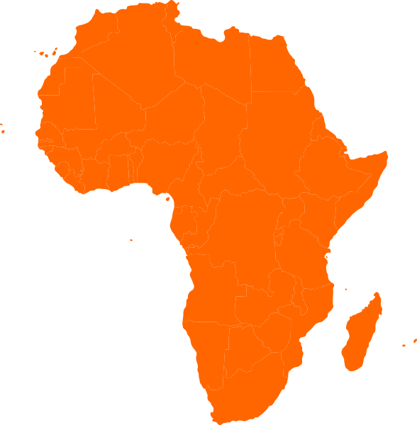
Which Term?
Ocean
Mountain
Island
Continent

Slide 5
Which Continent?
North America
South America
Asia
Europe

Slide 6
Which Ocean?
Pacific
Arctic
Atlantic
Indian

Slide 7
Which Ocean?
Pacific
Arctic
Atlantic
Indian

Slide 8
Which Continent?
North America
South America
Asia
Europe

Slide 9
Which Continent?
North America
South America
Asia
Europe

Slide 10
Which Definition?
Ocean
A stretch of high land that separates river systems.
One of four major bodies of salt water that surround the continents.
A large body of water completely or partly surrounded by land.
A place where a stream or river flows into a larger body of water.

Slide 11
Which Ocean?
Pacific
Arctic
Atlantic
Indian

Slide 12
Which Continent?
North America
Antarctica
Asia
Europe

Slide 13
Which Ocean?
Pacific
Arctic
Atlantic
Indian

Slide 14
Which Continent?
North America
Africa
Asia
Europe

