Slide 1
EUROPE
7th Grade World Geography

Slide 2
BC (BCE)
AD (CE)
Before Christ
Before the Common Era
Anno Domini
“The Year of Our Lord”
Common Era

Slide 3
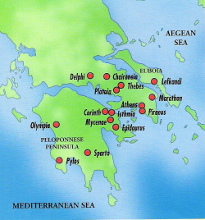
Classical Greece, 400 BC to 300s BC
Golden Age of Greece 400 BC
Polis – City State such as Athens or Sparta
Democracy or “Rule by the people”
Philosophy “love of wisdom”
Philosophers such as Aristotle and Socrates
Peloponnesian War 431 to 404 BC
Athens vs Sparta

Slide 4
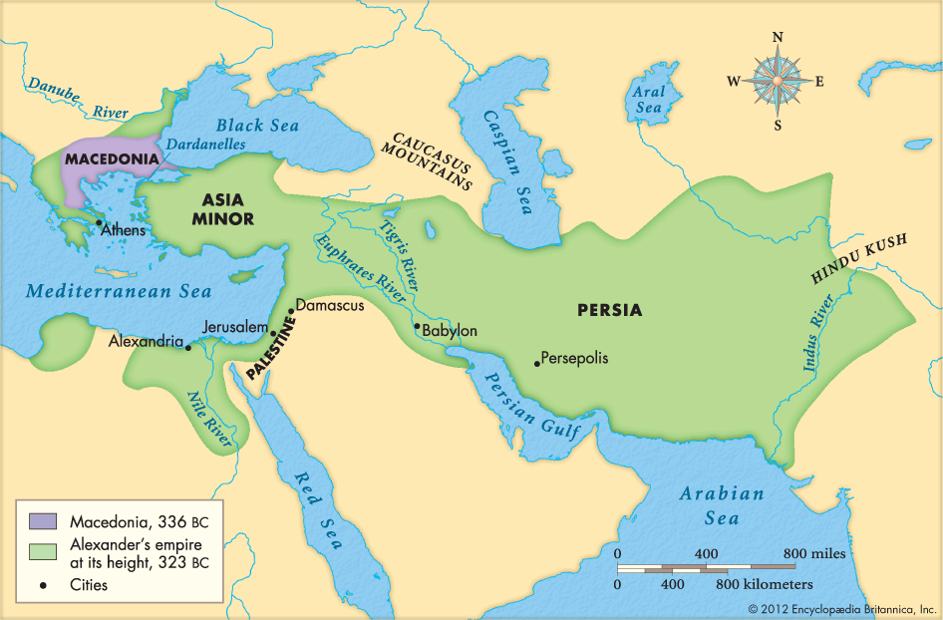
Classical Greece
Alexander the Great Spreads Greek Culture 300s BC

Slide 5
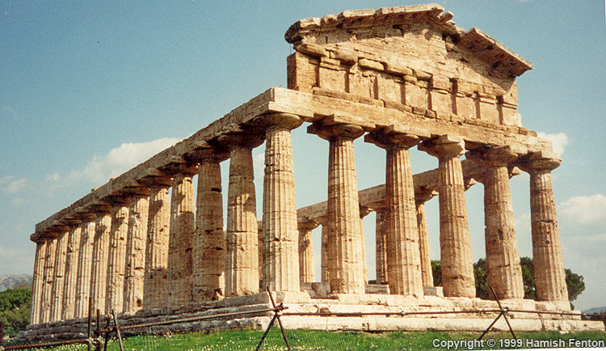

Slide 6
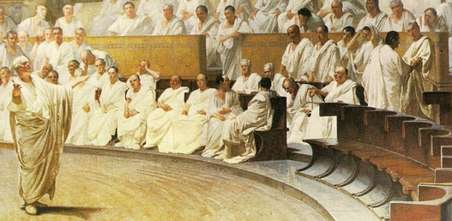
Roman Republic, 1000 BC to 146 BC
Rome settled 1000 BC
Supposedly founded by twin brothers Romulus and Remus
Early form of representative government
Ruled by Consuls and a Senate
12 Tables of Roman Law

Slide 7
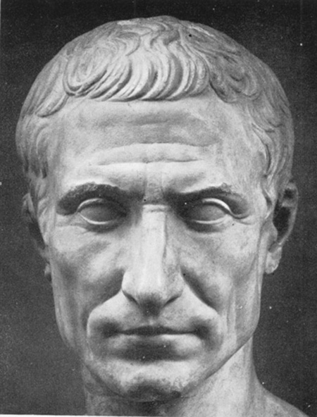
Roman Empire, 146 BC to 400s AD
Roman Republic became Roman Empire 146 BC
Ruled by Emperors (Caesars)
Well-organized, efficient cities
Architecture = Roman arch, Coliseum, aqueducts
Roman Roads
Civil War 44 to 31 BC
Pax Romana 31 BC
“Roman Peace” lasted 200 years

Slide 8
Roman Republic & Empire

Slide 9
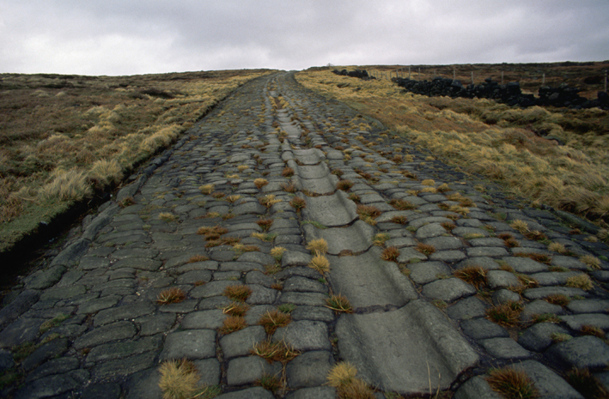
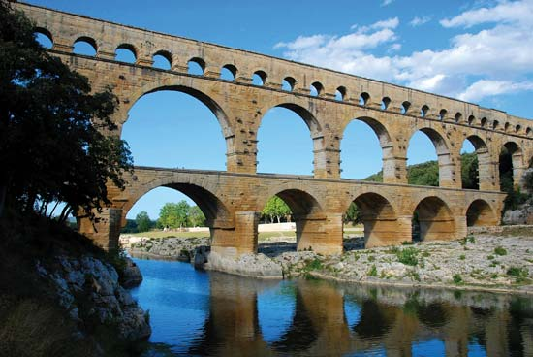
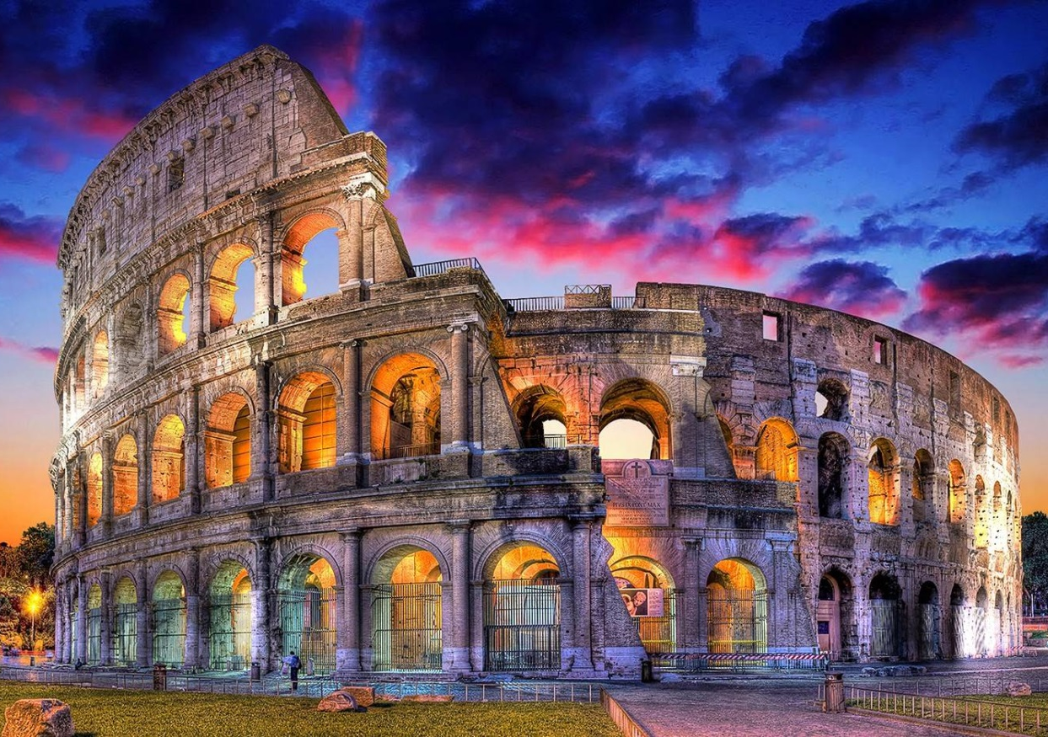

Slide 11
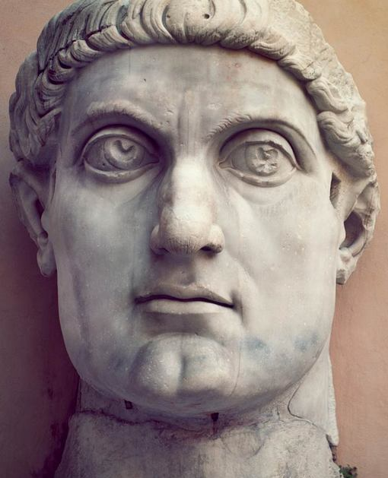
Eastern Roman Empire
Christianity became the official religion in 300s AD, by Emperor Constantine.
Capital moved to Constantinople in 330 AD
Invaded by Germans in 400s AD
Eastern Roman Empire or Byzantine Empire 400s to 1453 AD

Slide 12
