Slide 1
EUROPE
7th Grade World Geography

Slide 2
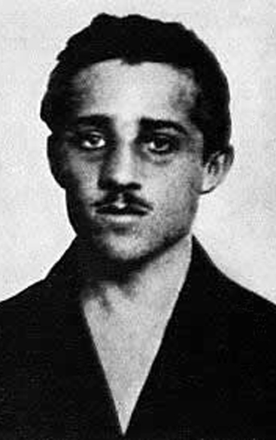
WWI, 1914 to 1918 AD
WWI “the Great War” Breaks out in Europe 1914 AD
Imperialism, Nationalism, Militarism, Alliances
Allied Powers
Russia, France, Great Britain, USA
Central Powers
Austria-Hungary, Germany, Ottoman Empire

Slide 3
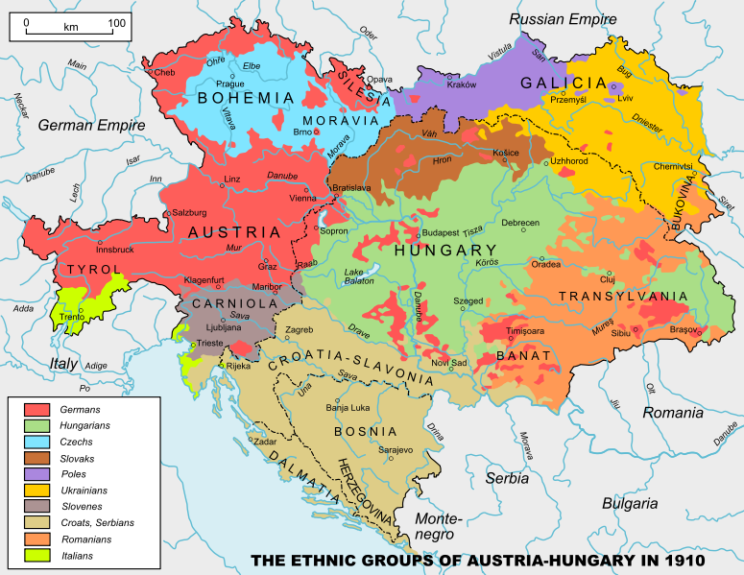

Slide 4
Allied Powers vs Central Powers
Serbia
Russia
France
Great Britain
(Triple Entente)
Japan
USA
(not until 1917)
Austria-Hungary
Germany
Romania & Bulgaria
Ottoman Empire

Slide 5
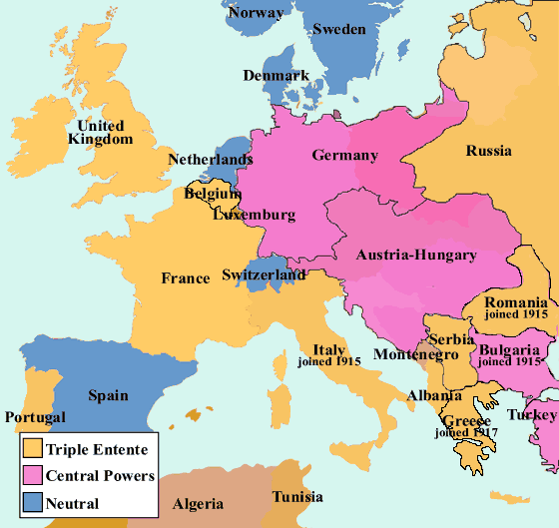

Slide 6
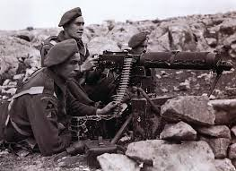
WWI
New Weapons
U-boats, Machine Guns, Flame throwers, Poison gas, Grenades, Tanks, Airplanes
Trench Warfare
Armistice signed 11:00 on 11/11/1918
Treaty of Versailles signed in 1919

Slide 7
LOSSES OF WW1
17 million dead, 20 million wounded (soldiers and civilians)
Britain = 750,000
France = 1.4 million
Russia = 1.7 million
USA = 116,000
Germany = 2 million
Serbia = 1.264 million, 28% of pop, 58% of male pop

Slide 8
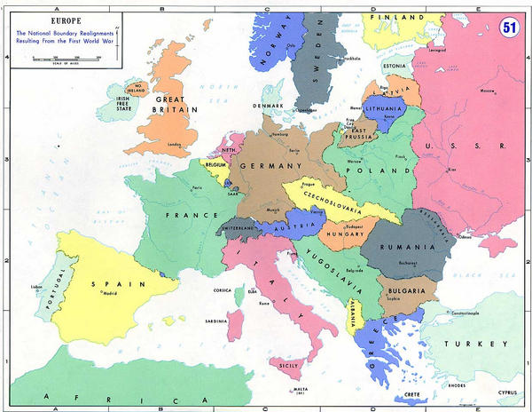
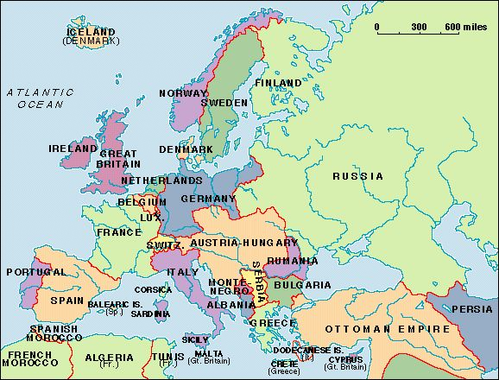

Slide 9
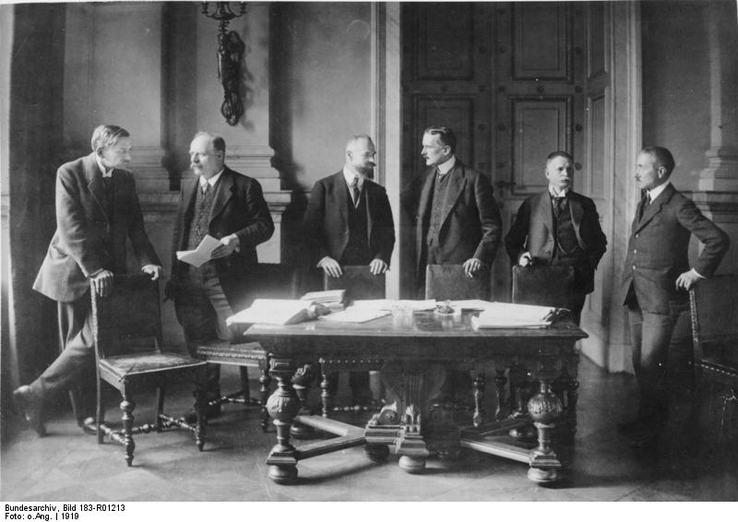
WWII, 1939 to 1945 AD
Causes
WWI & Treaty of Versailles, depression, fascism, militarism
Axis
Germany, Italy & Japan
Allies
Great Britain, France, China (and U.S. & Soviet Union in 1941)

Slide 10
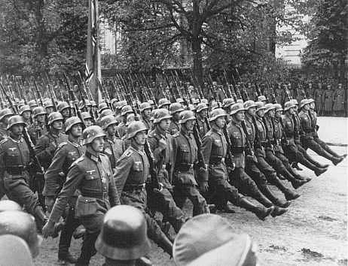
WWII
Policy of Appeasement towards Hitler & Mussolini
Violations of Treaty of Versailles
Annexation of Austria, March1938
Czechoslovakia, March 1939
Soviet non-aggression pact, August 1939

Slide 11
WWII
Poland invaded, September 1939
Germany invades France, Belgium, Netherlands May 1940
Germany invades USSR, June 1941
D-Day June 6, 1944
April 1945 Soviets reach Berlin and Hitler commits suicide
7 May 1945, unconditional German surrender (VE day May 8)
October 24, 1945 United Nations Established

Slide 12
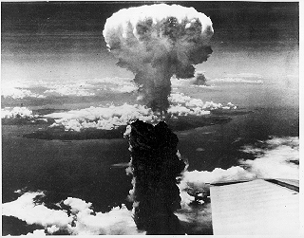
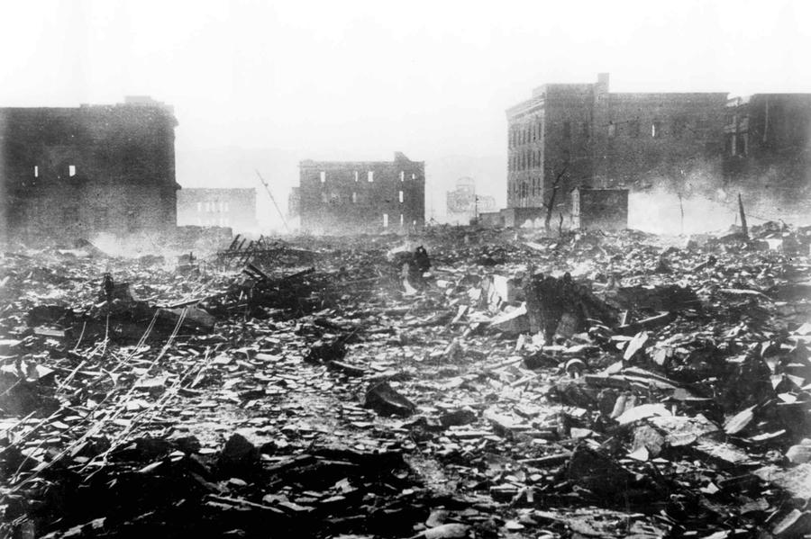
The End of WWII
Casualties
50 to 80 Million
Germany, 6.9 to 7.4 million
Soviet Union, 27 million

Slide 13
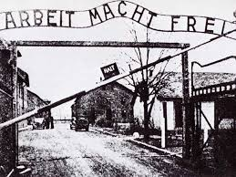
HOLOCAUST
Anti-Semitism
Jews blamed for economic situation, loss of WWI, etc.
Concentration Camps: labor, extermination, transit & collection
Oranienberg, 1933
Auschwitz, 1940 - 1.1 million killed
14 + camps
10 million killed, 6 million Jews

Slide 14
Cold War, 1945 to 1991
What is the Cold War?
A state of tensions existing between western capitalist countries (U.S., Great Britain, France) and eastern communist countries (Soviet Union, Soviet Bloc countries, China)
Communism
A theory of society, government, and economics
Took hold in Russia during the Russian Revolution of 1917—becomes the Soviet Union (USSR)

Slide 15
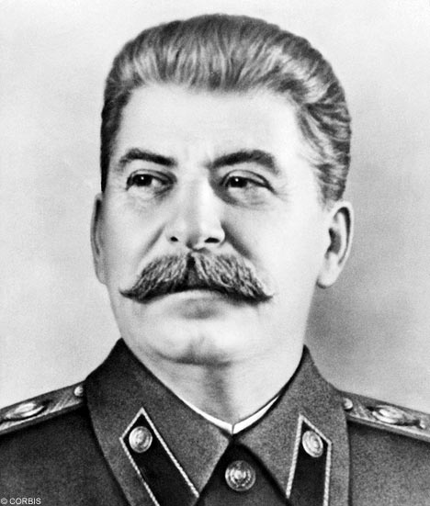
Joseph Stalin
Stalin gained power over the party in 1928.
Used terror and “purges” to silence his opposition.
Responsible for the deaths of around 20 million people.
Instituted a series of “5 Year Plans.”

Slide 16
Cold War, 1945 to 1991
Marshall Plan & Truman Doctrine 1948 AD
Berlin Blockade and Berlin Airlift 1948
North Atlantic Treaty Organization (NATO) 1949 AD
Mutually Assured Destruction -- Both sides (US and the West vs Soviet Union) have nuclear weapons 1950 AD
Warsaw Pact 1955 AD
Berlin Wall built 1961
Berlin Wall comes down 1989
End of Communism in Europe and Soviet Union breaks up 1991 AD

Slide 17
Post War Europe, 1991 to the Present
European Union 1993 AD
Most European members begin using the Euro as a common currency 2002 AD

