Slide 1
Human/ Environment Interaction
World Geography

Slide 2
Human/ Environment Interaction
humans adapt to their environment.
Since the beginning of time, people have found ways to survive with the resources available to them.

Slide 3
Inuit build igloos out of ice and snow

Slide 4
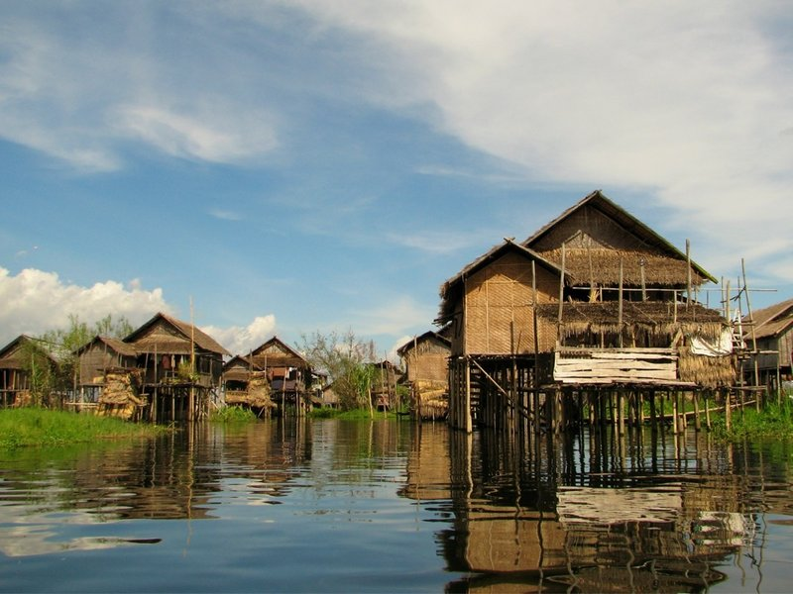
Villages, like this one in Myanmar, might be built on stilts for fishing or flooding

Slide 5
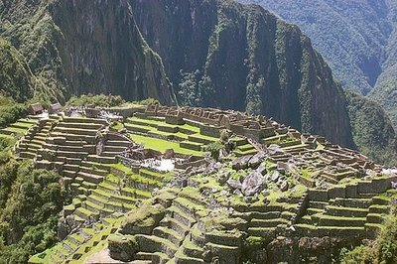
The Inca used terrace farming

Slide 6
Think/ pair/ share
Can you think of any other ways that humans adapt to their environment?

Slide 7
Human/ Environment Interaction
humans affect their environment.
Can be a positive or negative effect.

Slide 8
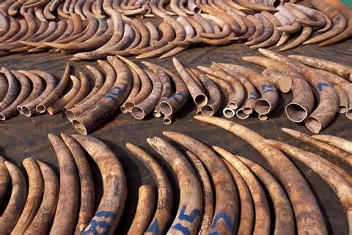
Poaching leads to animal endangerment/ extinction

Slide 9
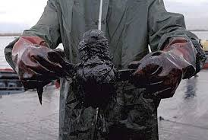
oil spills threaten the land, animals, and humans

Slide 10
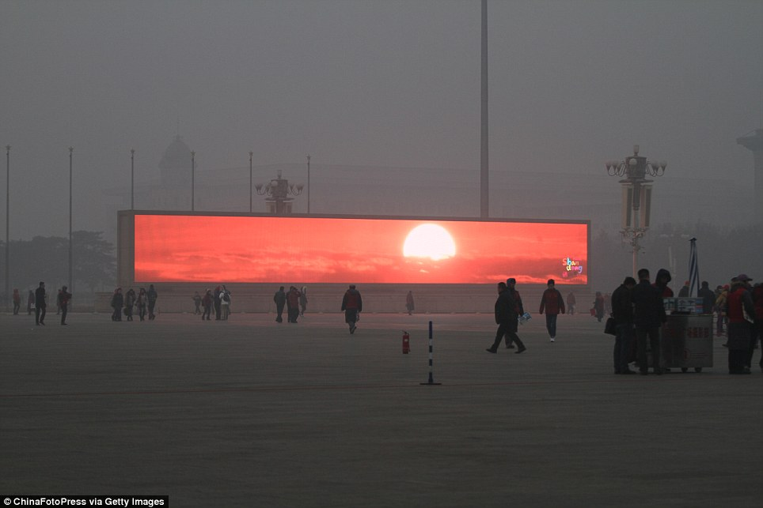
Beijing, China is so clouded in smog that they televise the sunrise

Slide 11
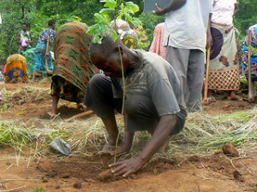
In Malawi, people plant trees in a deforested area

Slide 12
Think/ pair/ share
Can you think of other examples of people having a negative effect on the environment?
Can you think of any other positive examples?

