Slide 1
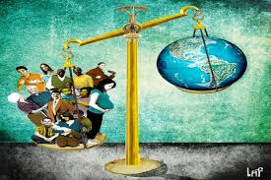
Population

Slide 2
India

Slide 3
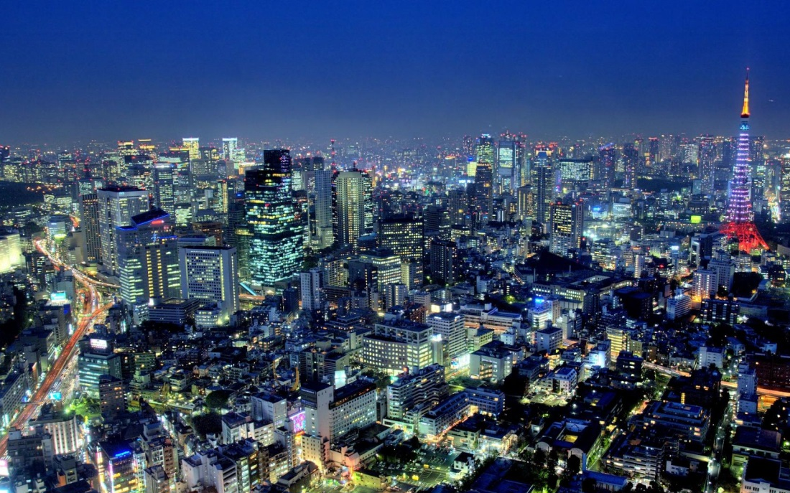
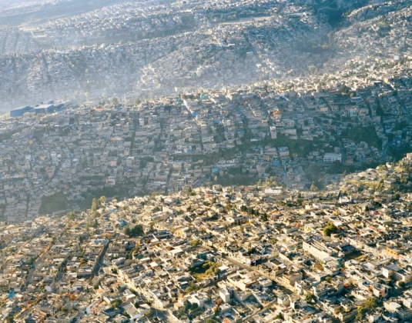
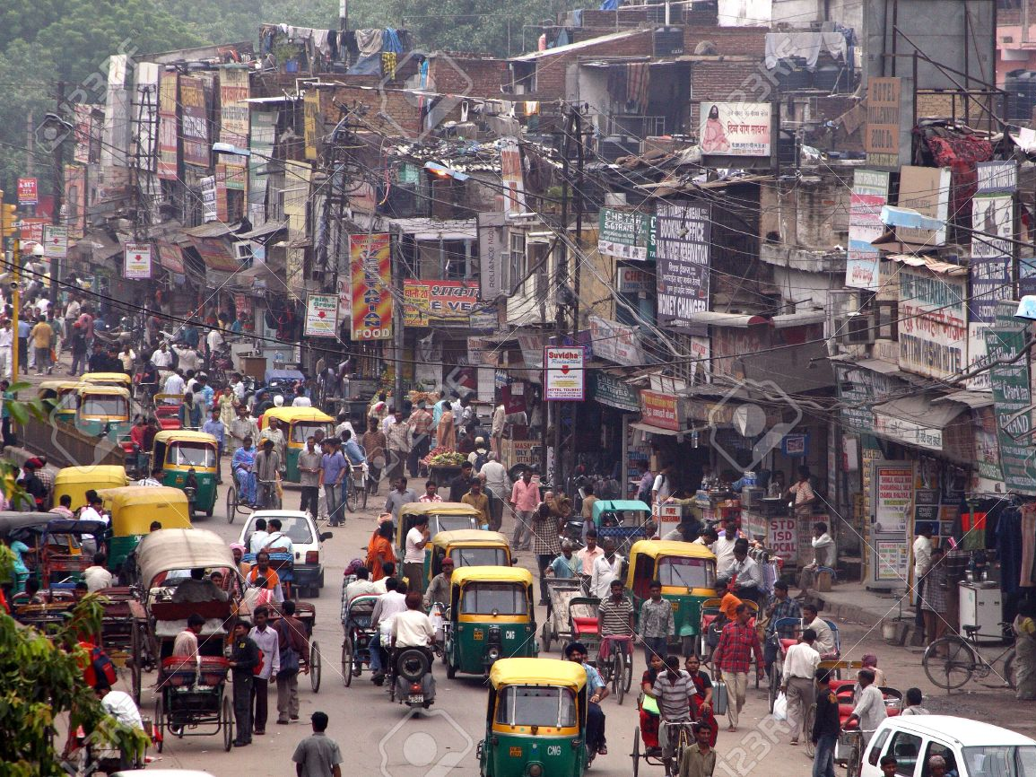
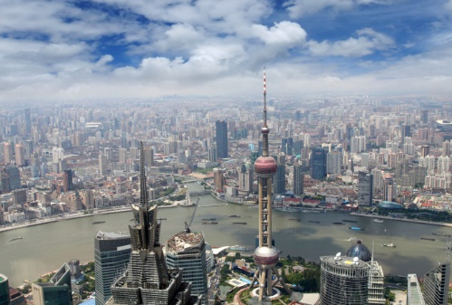

Slide 4
World’s most populous countries
1. China = 1,367,485,388
2. India =1,251,695,584
3. United States = 321,368,864
4. Indonesia = 255,993,674
5. Brazil = 204,259,812
6. Pakistan = 199,085,847
7. Nigeria = 181,562,056
8. Bangladesh = 168,957,745
9. Russia = 142,423,773
10. Japan = 126,919,659

Slide 5
The earth at night

Slide 6
World’s most populous cities
1. Tokyo, Japan = 37.2
2. Delhi, India = 25
3. Shanghai, China = 23
4. Mexico City, Mexico = 21
5. Mumbai, India = 21
6. Sao Paolo, Brazil = 21
7. Osaka, Japan = 20
8. Beijing, China = 20
9. New York, USA = 18.5
10. Cairo, Egypt = 18.5

Slide 8
Thinking Question
Based on the graph, what will the world population be in the next 10-20 years? How do you think this might impact the earth and the people on earth?

Slide 9
Reasons for population growth
Death Rate (number of people out of every 1000 who die)
Has declined due to:
Better health care
Better living conditions
Birthrate (number of children born each year for every 1000 people)
Has increased in Asia, Africa and Latin America.
In some areas, the population has been doubling every 25 years.

Slide 10
Problems of population growth
Natural Resources = things from nature which humans use.
Water, soil, plants, animals, fossil fuels, etc.
People want to live where they have access to natural resources.
Only about 30% of the earth’s surface is land; only about half of that land is usable to humans.
Consumption of Resources
Energy, water, lumber, land, housing, etc.
Sustainability = Can something (a particular resource) last?

Slide 11
Population distribution & density
Food shortages or famine
Since 1950 the food production has increased faster than the population on all continents except Africa.
Population Density = the average number of people living in a square mile or square kilometer.
Economic Strain
Jobs, rapid urbanization
Urbanization – people moving from the country to the city

Slide 12
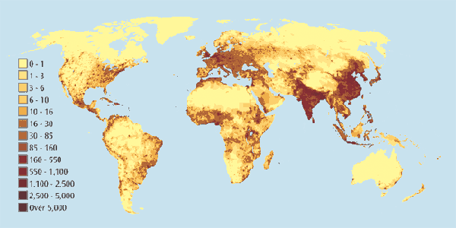
World Population Density

Slide 13
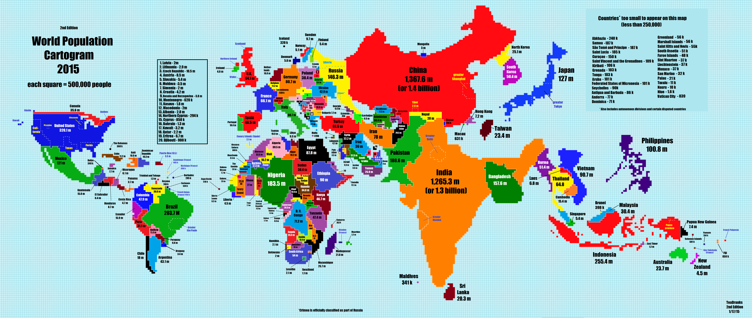

Slide 14
Water scarcity

Slide 15
Thinking question
What problems can arise from not having adequate access to fresh water?
What similarities do you notice between the population density maps and the water scarcity map?

Slide 16
World exports

Slide 18
Population Pyramids
You can find out a lot about a country’s potential for growth, among other things, by looking at it’s “population pyramid.”
Population Pyramid – a graph that tells us the amount of people of each age group in a population
A population pyramid is usually structured to show the amount or percent of people in each 5 year age group from 0-80+

Slide 19
Example of a Population Pyramid

Slide 20
How Do You Read A Population Pyramid?
Analyzing a Population Pyramid:
Look at the title
Analyze the shape
Look at the proportion of people in each age group
Interpret the data
We’re asking: What does this graph tell us about a population?

Slide 21
It’s All About the Shape!
The shape of a pyramid can tell us a lot about a country’s potential for growth
There are three (3) basic shapes of population pyramids
Triangle = rapid growth
Rectangle = slow growth
Beehive = zero to negative growth

Slide 22
The “Triangle”

Slide 23
The “Rectangle”

Slide 24
The “Beehive”

Slide 25
Pyramid Comparisons

Slide 26
The Usefulness of Pyramids
How can we use population pyramids?
To see how many of each age
To see how many dependants (between 0-15 and 65+)
To plan for the future

Slide 27
Thinking Questions
Please QUIETLY answer the following questions using complete sentences:
What’s the purpose of a “population pyramid”?
There are some countries of Asia that are growing rapidly and some that are not (very few). Give an example of a country you think might be growing very rapidly and one that may be growing very slowly. Why might this be the case?

Slide 29
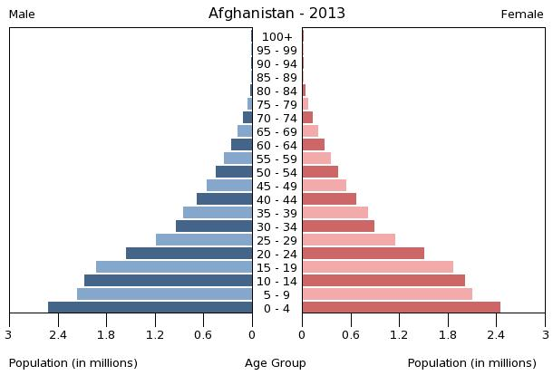
Afghanistan

Slide 30
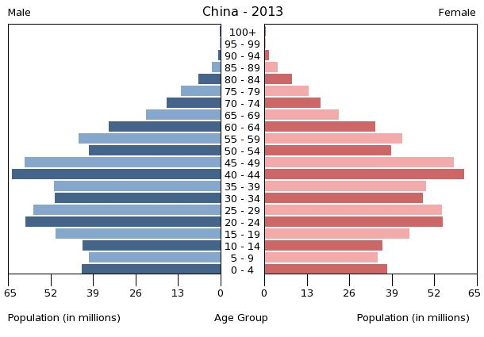
China

Slide 31
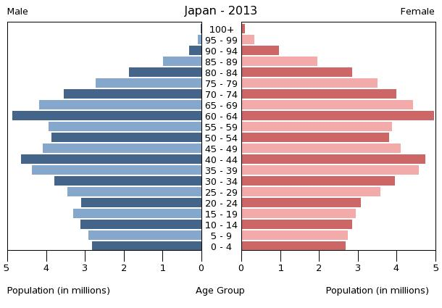
Japan

Slide 32
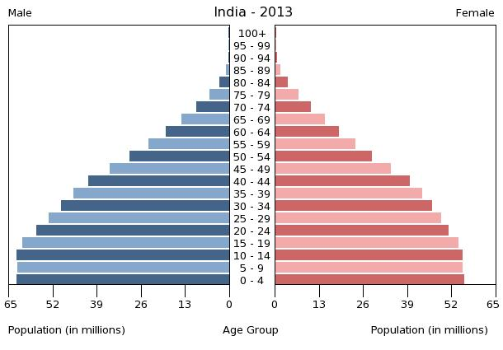
India

Slide 33
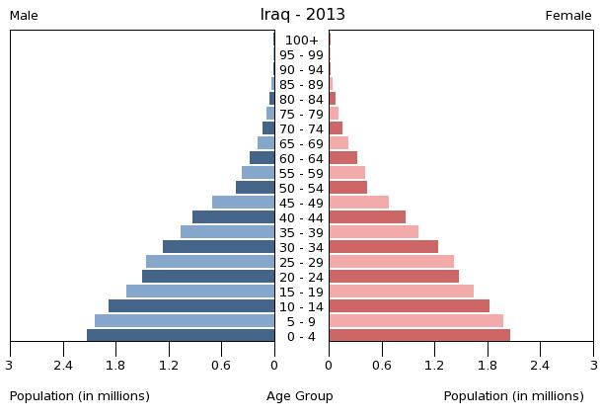
Iraq

Slide 34
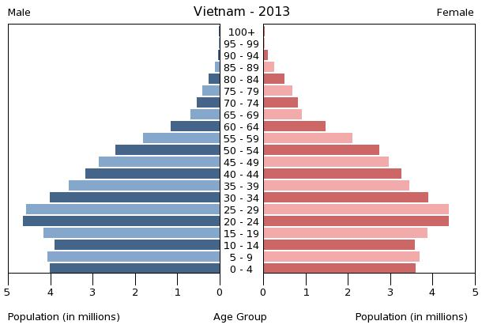
Vietnam

