Slide 1
REGIONS
7th Grade World Geography

Slide 2
Regions
Regions are areas of the world with similar, unifying characteristics.
Can be common physical or human characteristics.
Regions can be large or small.

Slide 3
What do these countries have in common?
Saudi Arabia
Location: SW Asia
Religion: Officially Muslim
Language: Arabic
Natural Resources: Oil
Climate: Dry, desert
Egypt
Location: North Africa
Religion: 90% Muslim
Language: Arabic
Natural Resources: Oil
Climate: Dry, desert
Jordan
Location: SW Asia
Religion: 97% Muslim
Language: Arabic
Natural Resources: phosphates, shale oil
Climate: mostly dry desert
Kuwait
Location: SW Asia
Religion: 76% Muslim
Language: Arabic
Natural Resources: oil, fishing
Climate: dry desert

Slide 4
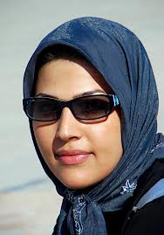
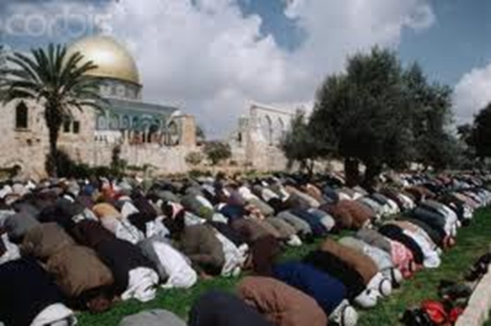
Middle East

Slide 5
What do these countries have in common?
Cambodia
Location: SE Asia
Religion: 96% Buddhist
Language: Khmer
Natural Resources: Oil, timber
Climate: Tropical
Thailand
Location: SE Asia
Religion: 93% Buddhist
Language: Thai
Natural Resources: Tin, rubber
Climate: Tropical
Vietnam
Location: SE Asia
Religion: 80% Non-religious
Language: Vietnamese
Natural Resources: phosphates, coal
Climate: Tropical in south, monsoonal in north
Burma
Location: SE Asia
Religion: 89% Buddhist
Language: Burmese
Natural Resources: Oil, timber
Climate: Tropical Monsoon

Slide 6
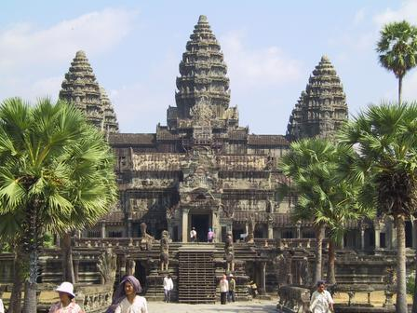
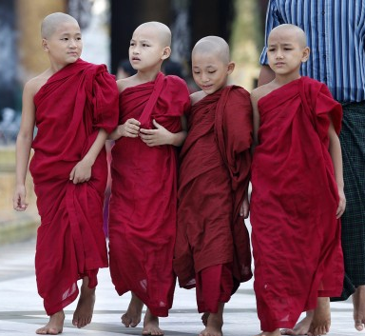
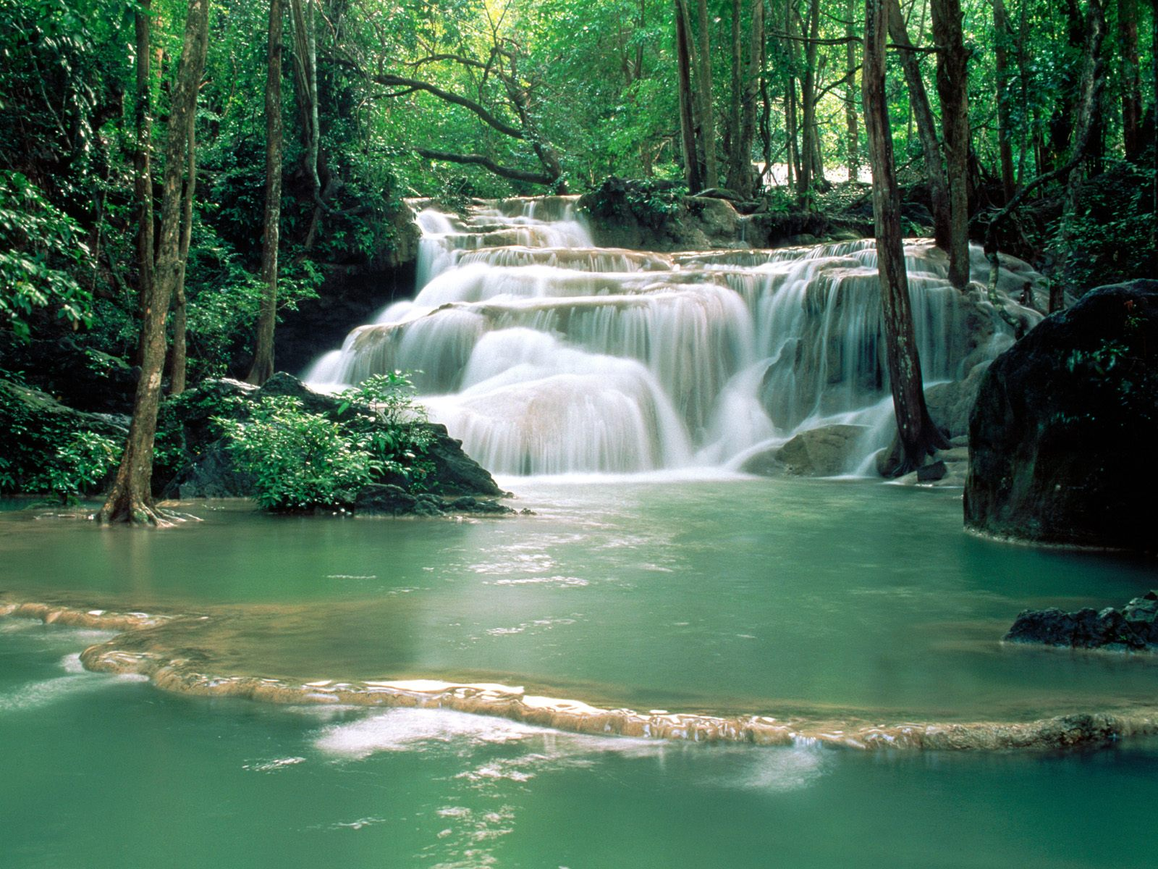
Southeast Asia

Slide 7
Can you think of any other regions around the world? Or here in the United States?

